Slide 1
CS 61C:
Great Ideas in Computer Architecture
Building Blocks for Datapath and Control
Instructors:
Krste Asanović and Randy H. Katz
http://inst.eecs.Berkeley.edu/~cs61c/fa17

Slide 2





You are Here!
Software Hardware
Parallel Requests
  Assigned to computer
  e.g., Search “Katz”
Parallel Threads
  Assigned to core
  e.g., Lookup, Ads
Parallel Instructions
  >1 instruction @ one time
  e.g., 5 pipelined instructions
Parallel Data
  >1 data item @ one time
  e.g., Add of 4 pairs of words
Hardware descriptions
  All gates @ one time
Programming Languages
Warehouse Scale Computer
Smart
Phone
Harness
Parallelism &
Achieve High
Performance
Computer
Core
…
Core
Memory (Cache)
Input/Output
Core
Instruction Unit(s)
Functional
Unit(s)
A₀+B₀
A₁+B₁
A₂+B₂
A₃+B₃
Today
Cache Memory
Logic Gates

Slide 3

Levels of Representation/Interpretation
High Level Language
Program (e.g., C)
temp = v[k];
v[k] = v[k+1];
v[k+1] = temp;
Compiler
Anything can be represented
as a number,
i.e., data or instructions
lw $t0, 0($2)
lw $t1, 4($2)
sw $t1, 0($2)
sw $t0, 4($2)
Assembly Language Program (e.g., RISC-V)
Assembler
0000 1001 1100 0110 1010 1111 0101 1000
1010 1111 0101 1000 0000 1001 1100 0110
1100 0110 1010 1111 0101 1000 0000 1001
0101 1000 0000 1001 1100 0110 1010 1111
Machine Language Program (RISC-V)
Machine Interpretation
Hardware Architecture Description
(e.g., block diagrams)
Architecture Implementation
Logic Circuit Description
(Circuit Schematic Diagrams)

Slide 4
Design Hierarchy
system
datapath
control
code
registers
state
registers
combinational
logic
multiplexer
comparator
register
logic
switching
networks

Slide 5
Agenda
Boolean Algebra
Timing and State Machines
Datapath Elements: Mux + ALU
RISC-V Lite Datapath
And, in Conclusion, …

Slide 6
Agenda
Boolean Algebra
Timing and State Machines
Datapath Elements: Mux + ALU
RISC-V Lite Datapath
And, in Conclusion, …

Slide 7
Boolean Algebra
Use plus for OR
  “logical sum”
Use product for AND (a•b or implied via ab)
  “logical product”
“Hat” to mean complement (NOT)
Thus
ab + a + c
= a•b + a + c
= (a AND b) OR a OR (NOT c )

Slide 8
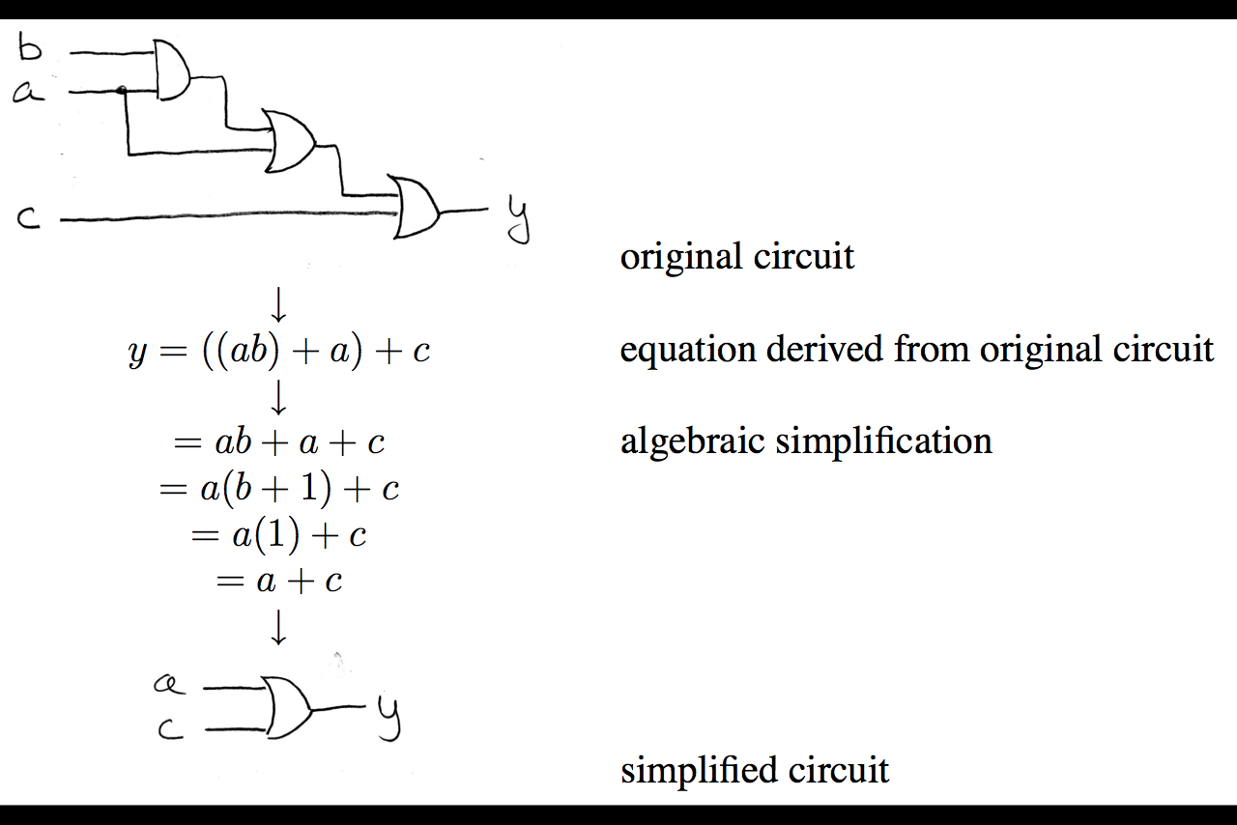
Boolean Algebra: Circuit & Algebraic Simplification

Slide 9
Laws of Boolean Algebra
X X = 0
X 0 = 0
X 1 = X
X X = X
X Y = Y X
(X Y) Z = X (Y Z)
X (Y + Z) = X Y + X Z
X Y + X = X
X Y + X = X + Y
X Y = X + Y
X + X = 1
X + 1 = 1
X + 0 = X
X + X = X
X + Y = Y + X
(X + Y) + Z = X + (Y + Z)
X + Y Z = (X + Y) (X + Z)
(X + Y) X = X
(X + Y) X = X Y
X + Y = X Y
Complementarity
Laws of 0’s and 1’s
Identities
Idempotent Laws
Commutativity
Associativity
Distribution
Uniting Theorem
Uniting Theorem v. 2
DeMorgan’s Law

Slide 10
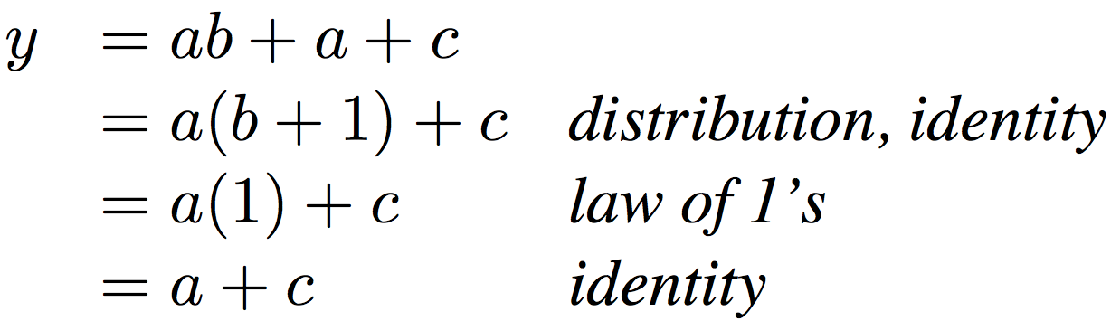
Boolean Algebraic Simplification Example
Notes:
Do on black board
First write truth table
Then minimize and check truth table
From distribution: a(b +1) + c
Froms laws of 0s and 1s: b+1 = 1
= a + c
Truth Table
a b c y
0 0 0 0
0 0 1 1
0 0 1 1

Slide 11
Boolean Algebraic Simplification Example
a b c y
0 0 0 0
0 0 1 1
0 1 0 0
0 1 1 1
1 0 0 1
1 0 1 1
1 1 0 1
1 1 1 1
Notes:
Do on black board
From distribution: a(b +1) + c
Froms laws of 0s and 1s: b+1 = 1
= a + c
Truth Table
a b c y
0 0 0 0
0 0 1 1
0 1 0 0
0 1 1 1
1 0 0 1
1 0 1 1
1 1 0 1
1 1 1 1

Slide 12
Agenda
Boolean Algebra
Timing and State Machines
Datapath Elements: Mux + ALU
RISC-V Lite Datapath
And, in Conclusion, …

Slide 13
Types of Circuits
Synchronous Digital Systems consist of two basic types of circuits:
  Combinational Logic (CL) circuits
    Output is a function of the inputs only, not the history of its execution
    E.g., circuits to add A, B (ALUs)
    Last lecture was comninational logic
  Sequential Logic (SL)
    Circuits that “remember” or store information
    aka “State Elements”
    E.g., memories and registers (Registers)
    Rest of today’s lecture is sequential logic

Slide 14
Design Hierarchy
system
datapath
control
code
registers
state
registers
combinational
logic
multiplexer
comparator
register
logic
switching
networks

Slide 15
Uses for State Elements
Place to store values for later re-use:
  Register files (like $1-$31 on the RISC-V)
  Memory (caches and main memory)
Help control flow of information between combinational logic blocks
  State elements hold up the movement of information at input to combinational logic blocks to allow for orderly passage

Slide 16
Program Counter: First Design
Program Counter “PC”
  Instruction address
  Next PC: add 4 to current value
  Let’s try …
PC
PC + 4
Something is not quite right:
  PC and PC+4 simutaneously on same wire???

Slide 17
Fix
Memory element breaks the feedback loop
How does it work?

Slide 18
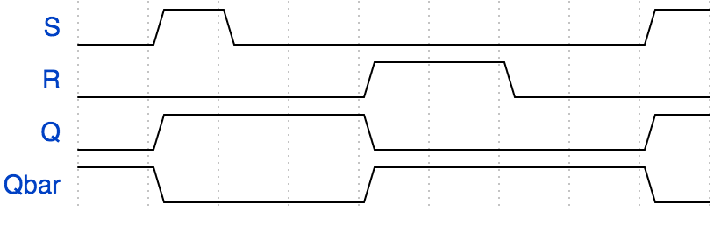
RS Latch
0
1
0
0
1
1
0
Q and Qbar keep state,
despite S deasserted → memory
Time

Slide 19
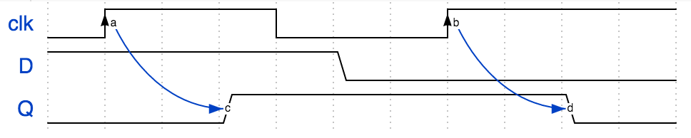
(Positive) Edge Triggered Flip-Flop
D
Q
clk
RS latch operates on input levels
D FF operates on (clock) edges
Clock “clk”
Time
Notes:
{signal: [ {name: 'clk', wave: '0H..l..H...', node: '.a.....b'}, {name: 'D', wave: '1....0.....'}, {name: 'Q', wave: '0..1.....0.', node: '...c.....d'},], edge: [ 'a~->c', 'b~->d',]}

Slide 20
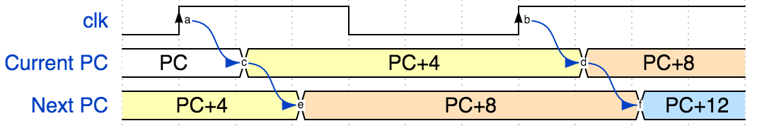
Program Counter: Improved Design
Current PC
Next PC
Notes:
{signal: [ {name: 'clk', wave: '0H..l..H...', node: '.a.....b'}, {name: 'Current PC', wave: '2.3.....4..', node: '..c.....d', data: 'PC PC+4 PC+8'}, {name: 'Next PC', wave: '3..4.....5.', node: '...e.....f', data:'PC+4 PC+8 PC+12'},], edge: [ 'a~>c', 'b~>d', 'c~>e', 'd~>f']}

Slide 21
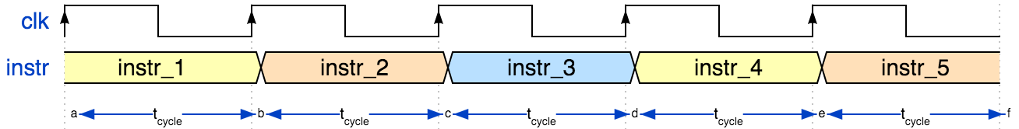
Clock
f_{s} = 1/ t_{cycle}
Clock frequency f_{s} | Period t_{cycle} = 1/f_{s}
CPU 2.5 GHz | 400 ps
Drum/heartbeat, 1Hz | 1 s
Notes:
Faster processors enabled
digital audio ~ 1980
digital video 199x
… now enables entirely new functions (e.g. search engines) that did not even exist with analog processing.
But: many physical signals are inherently analog. E.g. my voice: I cannot speak ”digital”, and you could not understand me anyway.
{signal: [ {name: 'clk', wave: 'P....'}, {name: 'instr', wave: '34534', data: 'instr_1 instr_2 instr_3 instr_4 instr_5'}, {node: 'abcdef'}], edge: ['a<->b t<sub>cycle', 'c<->b t<sub>cycle', 'c<->d t<sub>cycle', 'd<->e t<sub>cycle', 'e<->f t<sub>cycle', ], config: { hscale: 3 }}

Slide 22
Maximum Clock Speed
How fast can the PC circuit operate?
  I.e. what is the maximum clock frequency?
Let’s look at the timing requirements of each part
  Let’s start with the flip-flop

Slide 23
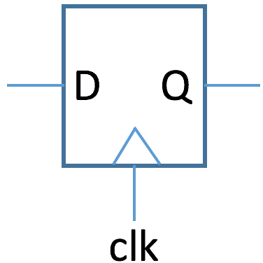
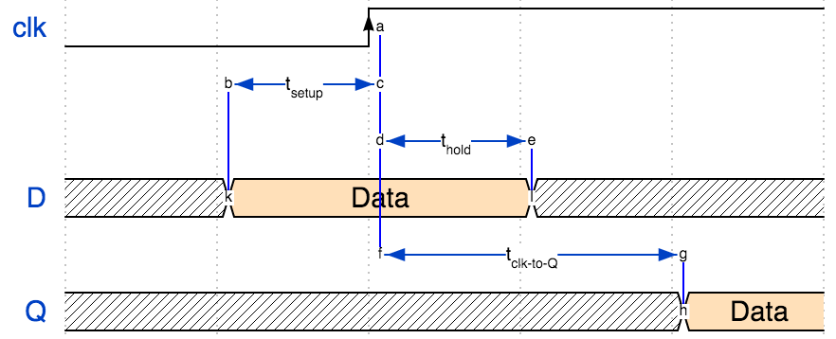
Flip-Flop Timing
Notes:
{signal: [ {name: 'clk', wave: '0.H..', node: '..a'}, { node: '.bc'}, { node: '..de'}, {name: 'D', wave: 'x4.x.', node: '.k.l', data: 'Data'}, { node: '..f.g'}, {name: 'Q', wave: 'x...4', node: '....h', data:'Data'},], edge: [ 'b<->c t<sub>setup', 'k-b', 'a-f', 'd<->e t<sub>hold', 'e-l', 'f<->g t<sub>clk-to-Q', 'g-h' ], config: { hscale: 1.5 }}

Slide 24
Flip-Flop Timing
Time | Description
t_{setup} | time during which D must not change before positive clock edge
t_{hold} | time during which D must not change after positive clock edge
t_{clk-to-Q} | delay after positive clock edge after which D appears at Q output

Slide 25
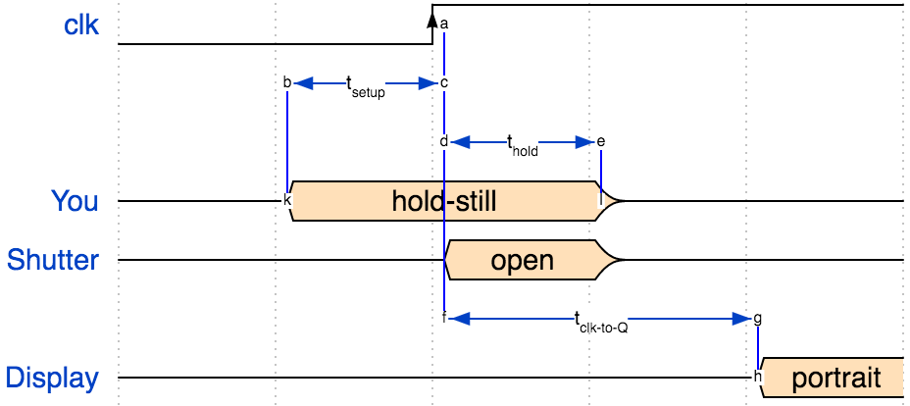
Camera Analogy
Notes:
{signal: [ {name: 'clk', wave: '0.H..', node: '..a'}, { node: '.bc'}, { node: '..de'}, {name: 'You', wave: 'z4.z.', node: '.k.l', data: "hold-still"}, {name: 'Shutter', wave: 'z.4z.', node: '...h', data:'open'}, { node: '..f.g'}, {name: 'Display', wave: 'z...4', node: '....h', data:'portrait'},], edge: [ 'b<->c t<sub>setup', 'k-b', 'a-f', 'd<->e t<sub>hold', 'e-l', 'f<->g t<sub>clk-to-Q', 'g-h' ], config: { hscale: 1.5 }}

Slide 26
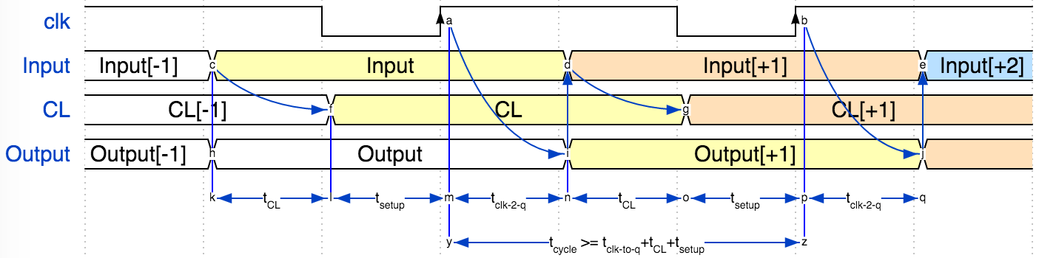
Maximum Clock Speed
t_{CL}
Clock
Input
Combinatorial
Logic
(CL)
Register
(flip-flops)
CL
Output
Optional Feedback
Notes:
{signal: [ {name: 'clk', wave: 'H.lH.lH.', node: '...a..b'}, {name: 'Input', wave: '23..4..5', node: '.c..d..e', data: 'Input[-1] Input Input[+1] Input[+2]' }, {name: 'CL', wave: '2.3..4..', node: '..f..g..', data: 'CL[-1] CL CL[+1]' }, {name: 'Output', wave: '22..3..4', node: '.h..i..j', data: 'Output[-1] Output Output[+1]' }, {node: '.klmnopq'}, {node: '...y..z'},], edge: [ 'k<->l t<sub>CL', 'c-k', 'l-f', 'l<->m t<sub>setup', 'm-a', 'm<->n t<sub>clk-2-q', 'i-n', 'c~->f', 'a~->i', 'i->d', 'n<->o t<sub>CL', 'o<->p t<sub>setup', 'p<->q t<sub>clk-2-q', 'd~->g', 'b~->j', 'j->e', 'y<->z t<sub>cycle</sub> >= t<sub>clk-to-q</sub>+t<sub>CL</sub>+t<sub>setup</sub>', 'a-y', 'b-z'], config: { hscale: 2 }}

Slide 27
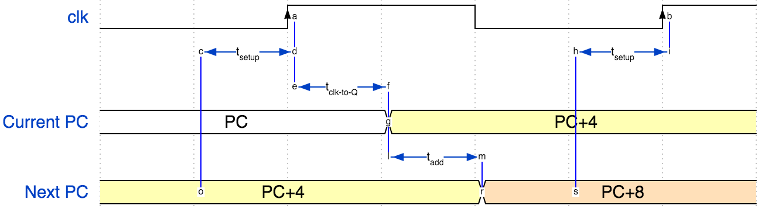
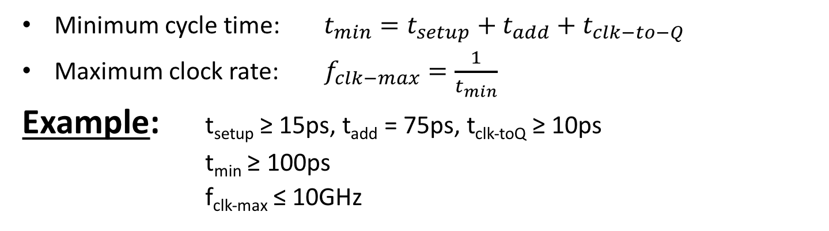
Maximum PC Clock Speed
Minimum cycle time: $t_{min}=t_{setup}+t_{add}+t_{clk−to−Q}$
Maximum clock rate: $f_{clk−max}=\frac{1}{t_{min}}$
Example: t_{setup} ≥ 15ps, t_{add} = 75ps, t_{clk-toQ} ≥ 10ps
t_{min} ≥ 100ps
f_{clk-max} ≤ 10GHz
Notes:
{signal: [ {name: 'clk', wave: '0.H.l.H', node: '..a...b'}, { node: '.cd..hi'}, { node: '..ef'}, {name: 'Current PC', wave: '2..3...', node: '...g', data: 'PC PC+4 PC+8'}, { node: '...lm'}, {name: 'Next PC', wave: '3...4..', node: '.o..rs', data:'PC+4 PC+8 PC+12'},], edge: [ 'c<->d t<sub>setup', 'c-o', 'a-d', 'e<->f t<sub>clk-to-Q', 'd-e', 'f-g', 'l<->m t<sub>add', 'g-l', 'm-r', 'h<->i t<sub>setup', 'h-s', 'b-i' ], config: { hscale: 2 }}

Slide 28
Design Hierarchy
system
datapath
control
code
registers
state
registers
combinational
logic
multiplexer
comparator
register
logic
switching
networks

Slide 29
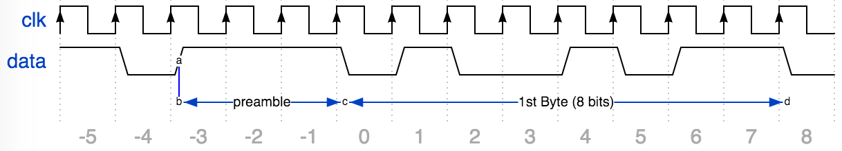
Example: Serial Communication
Wifi sends data “1 bit at a time”
How do we know where a byte “starts”?
Send “preamble …”
  E.g. 3 one’s in a row
Notes:
{signal: [ {name: 'clk', wave: 'P.............'}, {name: 'data', wave: '101..010.101.0', node: '..a', data: '1 0 1 1'}, {node: '..b..c.......d'}], edge: [ 'b<->c preamble', 'c<->d 1st Byte (8 bits)', 'a-b'],foot: {tock:-5 }, config: { hscale: 1 }}

Slide 30
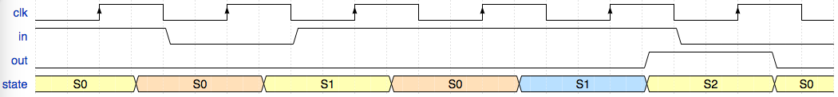
FSM* to Detect 3 One’s
* FSM = Finite State Machine
FSM to detect the occurrence of 3 consecutive 1’s in the input.
State transition diagram:
Notes:
{signal: [ {name: 'clk', wave: 'l.H.l.H.l.H.l.H.l.H.l.H.l'}, {name: 'in', wave: '1...0...1...........0....'}, {name: 'out', wave: '0..................1...0.'}, {name: 'state', wave: '3..4...3...4...5...3...3.', data:['S0', 'S0', 'S1', 'S0', 'S1', 'S2', 'S0']},]}

Slide 31
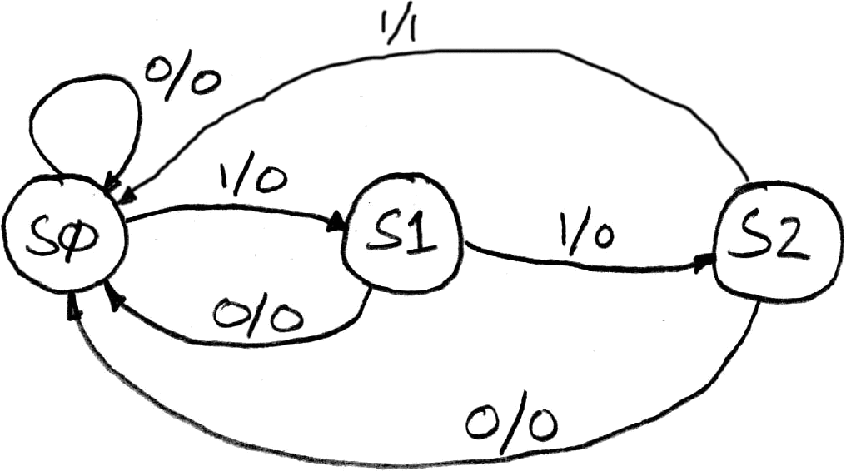
FSM* to Detect 3 One’s
* FSM = Finite State Machine
FSM to detect the occurrence of 3 consecutive 1’s in the input.
State transition diagram:
Input/output
S1: detected 1
State transitions are controlled by
the clock: on each clock cycle the FSM
checks the inputs,
transitions to a new state, and
produces a new output …
S0: idle
S2: detected 11
Notes:
{signal: [ {name: 'clk', wave: 'l.H.l.H.l.H.l.H.l.H.l.H.l'}, {name: 'in', wave: '1...0...1...........0....'}, {name: 'out', wave: '0..................1...0.'}, {name: 'state', wave: '3..4...3...4...5...3...3.', data:['S0', 'S0', 'S1', 'S0', 'S1', 'S2', 'S0']},]}

Slide 32
FSM Combinatorial Logic
State Encoding
Truth Table
State | Code
Current State | Input | Next State | Output

Slide 33
FSM Combinatorial Logic
State Encoding
Truth Table
State | Code
PS | Input | NS | Output
XX | 0 | 00 | 0
00 | 1 | 01 | 0
01 | 1 | 10 | 0
10 | 1 | 00 | 1
11 | X | 00 | 0
State | Code
S0 | 00
S1 | 01
S2 | 10
unused | 11

Slide 34
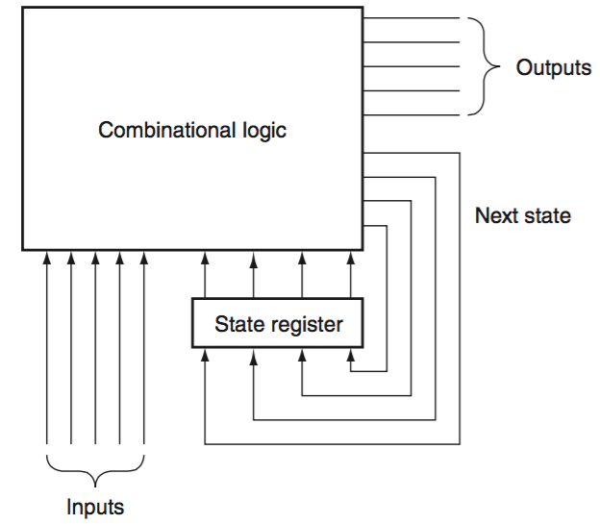
Hardware Implementation of FSM
clock

Slide 35
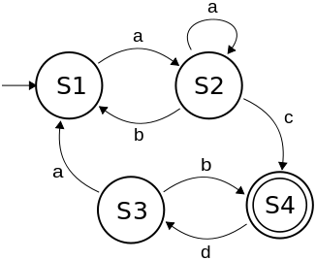
Finite State Machines (FSM) - Summary
Describe computation over time
Represent FSM with “state transition diagram”
Start at given state and input, follow some edge to next (or same) state
With combinational logic and registers, any FSM can be implemented in hardware
state transition diagram

Slide 36
Administrivia
Homework 2 set to be released Friday
  It will be multiple-choice and free response style (similar to HW0)
  Due in next Friday (in 1 week)
Project 1 Part 1 will also be released Friday
  Due Monday, Oct 9
Homework 1 regrades:
  Google form will be released tonight
  Instructions and guidelines will be on the piazza post

Slide 37
Break!
10/5/17
Fall 2017 - Lecture #10

Slide 38
Agenda
Boolean Algebra
Timing and State Machines
Datapath Elements: Mux + ALU
RISC-V Lite Datapath
And, in Conclusion, …

Slide 39
Design Hierarchy
system
datapath
control
code
registers
state
registers
combinational
logic
multiplexer
comparator
register
logic
switching
networks

Slide 40
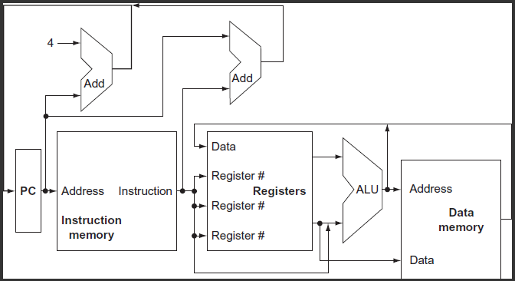
Conceptual RISC-V Datapath

Slide 41
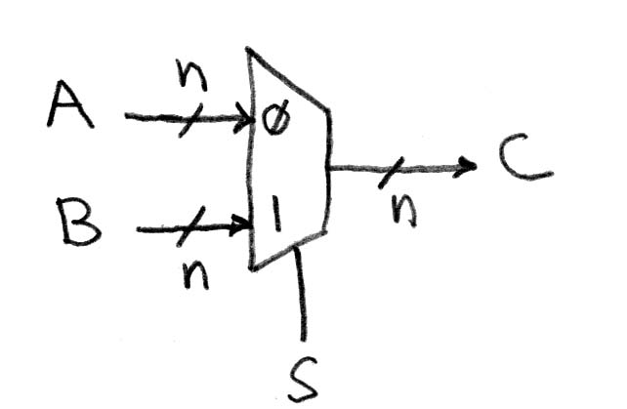
Data Multiplexer
(e.g., 2-to-1 x n-bit-wide)
“mux”
Notes:
Go to Logisim and do design from mux

Slide 42
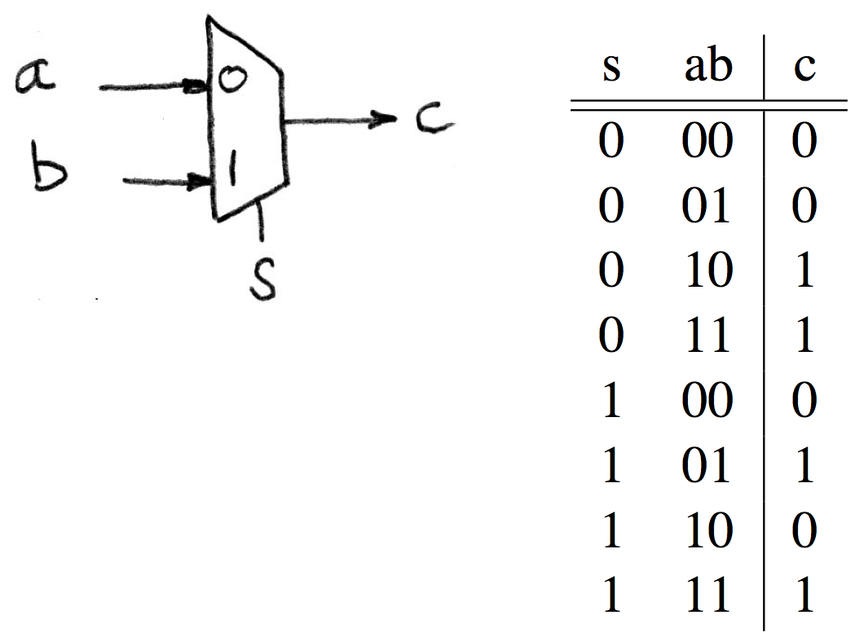
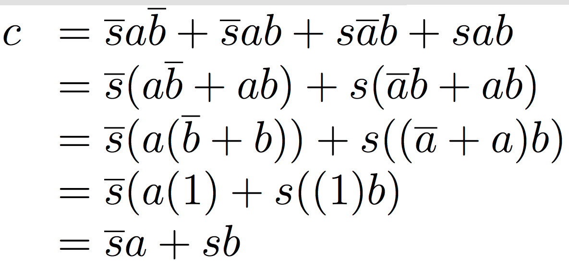
N Instances of 1-bit-Wide Mux

Slide 43
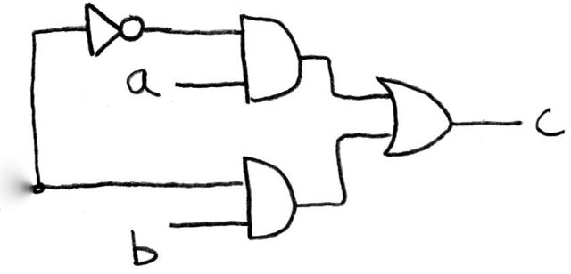
How Do We Build a
1-bit-Wide Mux (in Logisim)?
s
Notes:
Draw on Board, Build in Logisim, create as subcircuit my mux
Make s north facing

Slide 44
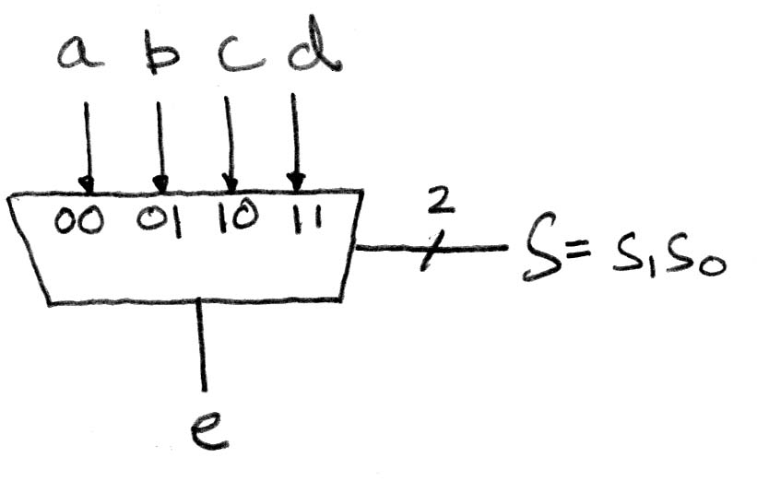
4-to-1 Multiplexer
How many rows in TT?

Slide 45
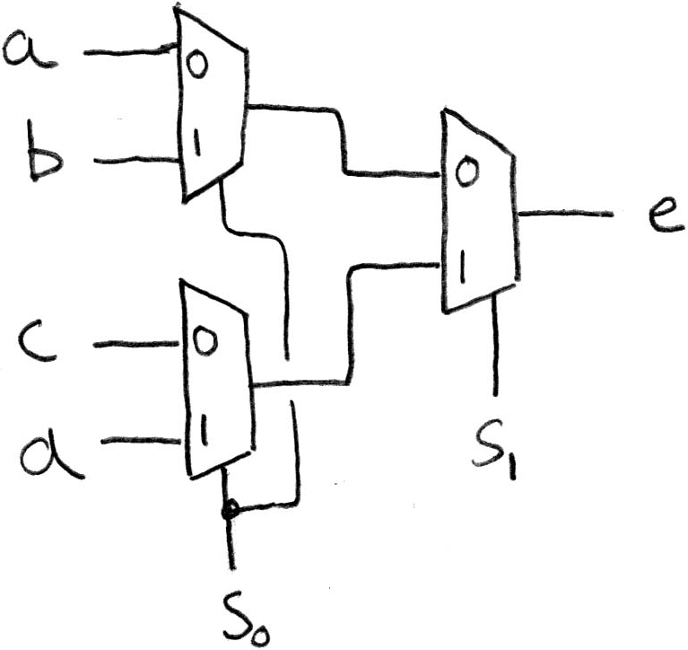
Alternative Hierarchical Approach
(in Logisim)

Slide 46
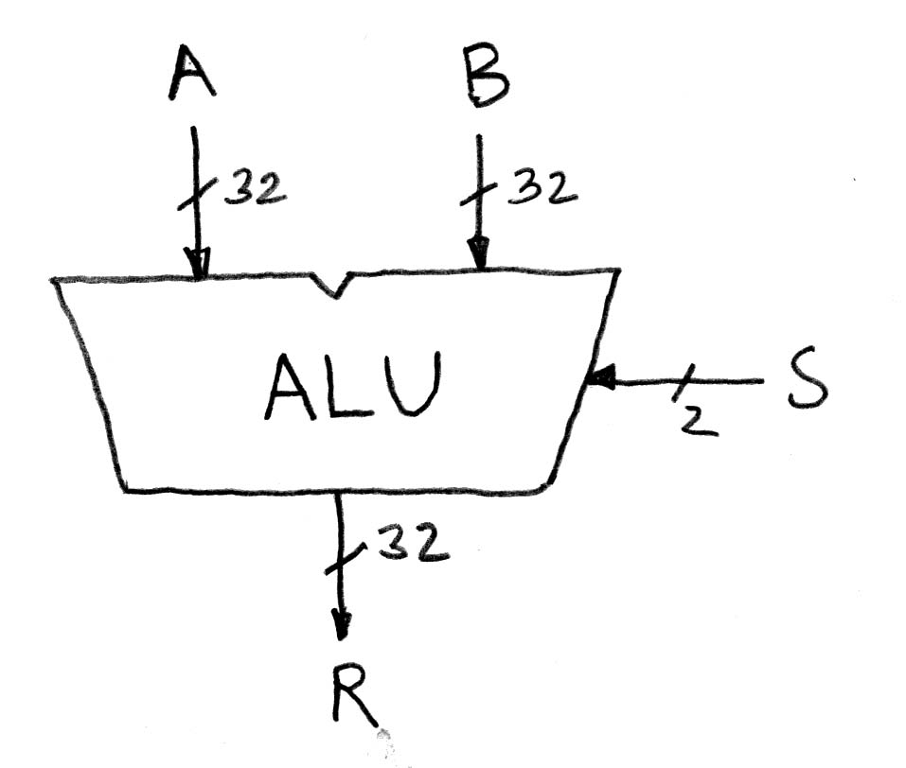
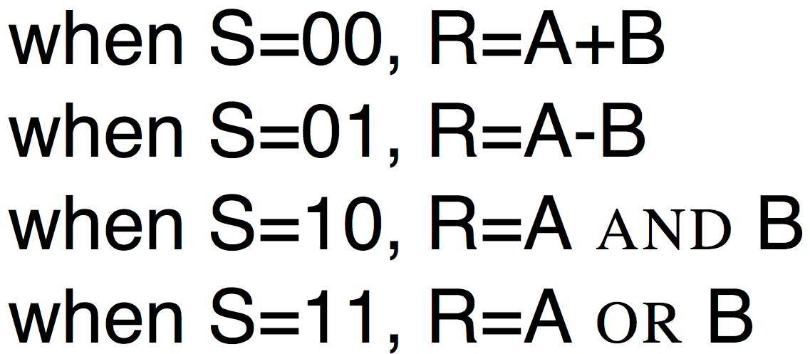
Arithmetic and Logic Unit
Most processors contain a special logic block called “Arithmetic and Logic Unit” (ALU)
We’ll show you an easy one that does ADD, SUB, bitwise AND, bitwise OR

Slide 47
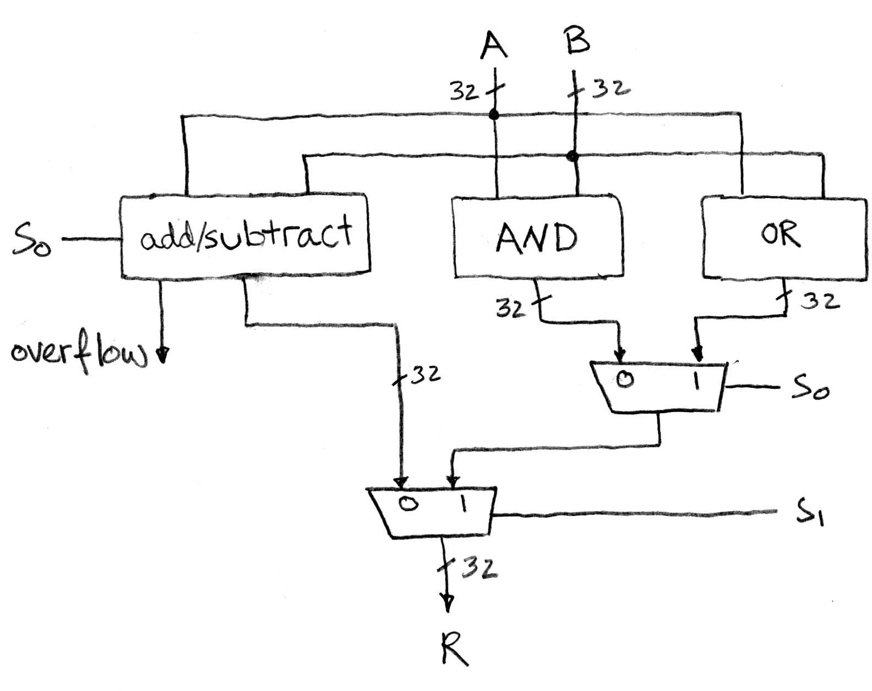
Simple ALU

Slide 48
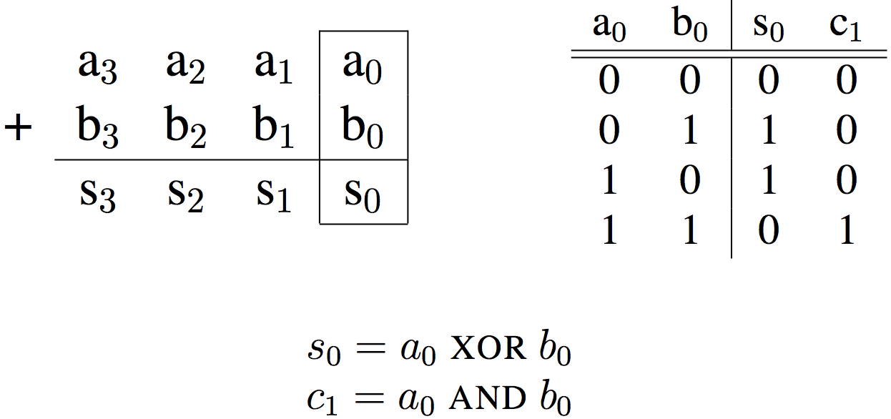
Adder/Subtractor: One-bit adder Least Significant Bit

Slide 49
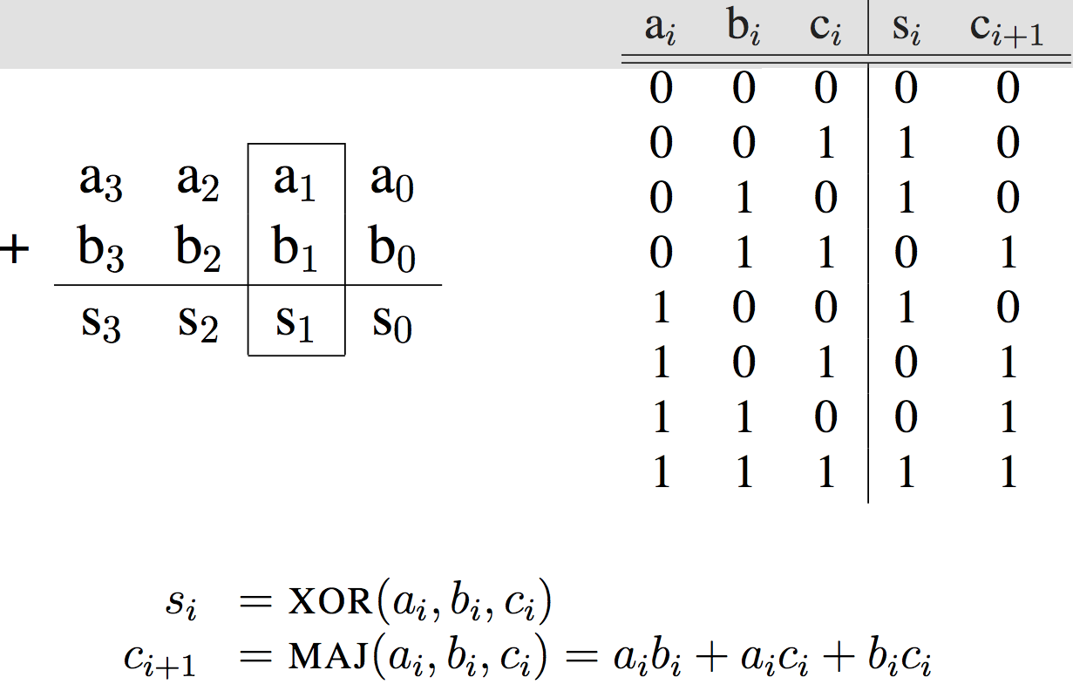
Adder/Subtractor: One-bit adder (1/2) …

Slide 50
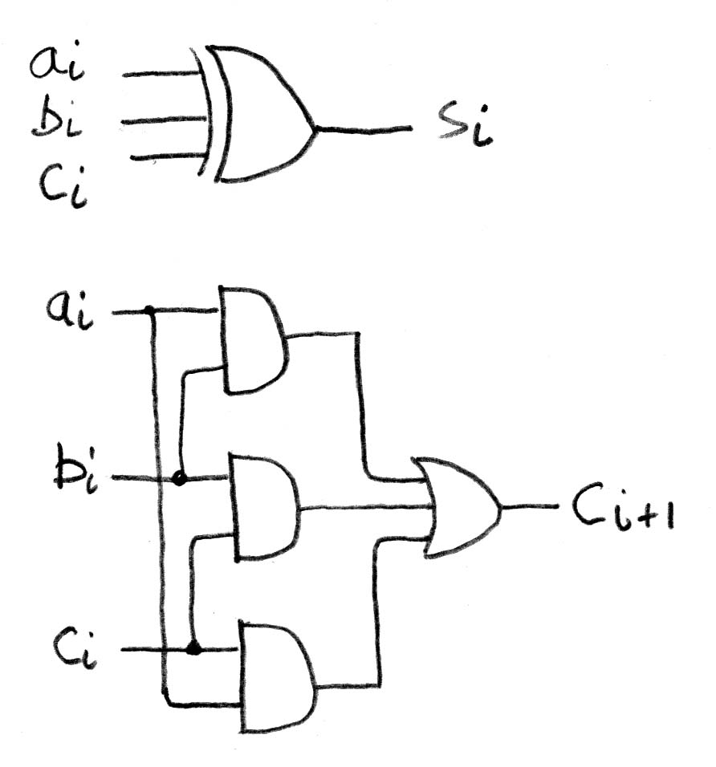
Adder/Subtractor: One-bit Adder (2/2) …

Slide 51
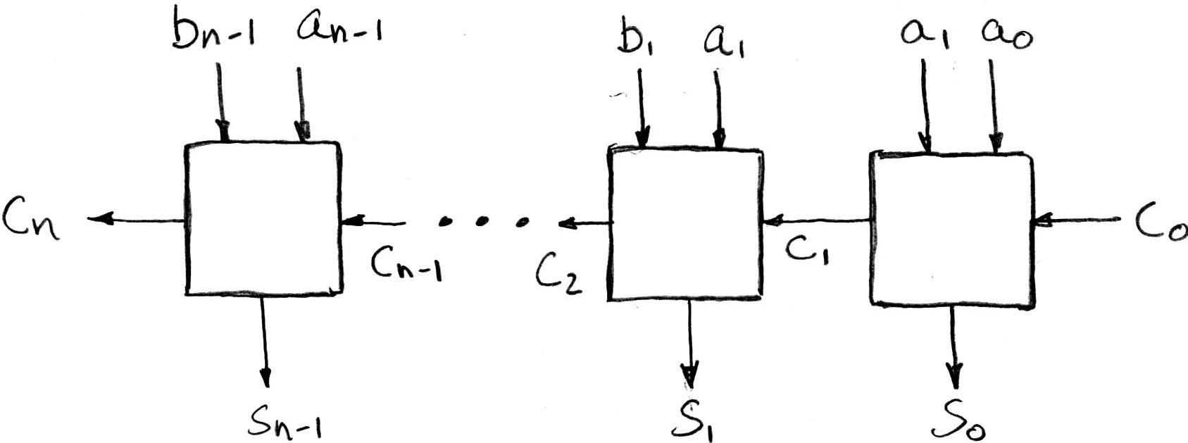
N x 1-bit Adders ⇒ 1 N-bit Adder
Connect Carry Out i-1 to Carry in i:
b₀
+
+
+

Slide 52
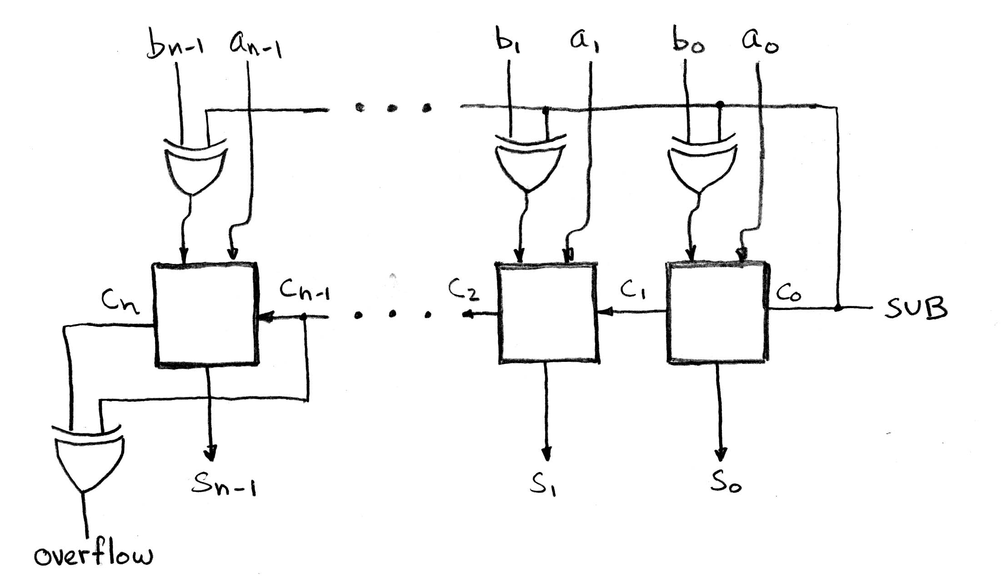
Twos Complement Adder/Subtractor

Slide 53
Critical Path
When setting clock period in synchronous systems, must allow for worst case
Path through combinational logic that is worst case called “critical path”
  Can be estimated by number of “gate delays”: Number of gates must go through in worst case
Idea: Doesn’t matter if speedup other paths if don’t improve the critical path
What might critical path of ALU?

Slide 54
Break!
10/5/17
Fall 2017 - Lecture #10

Slide 55
Agenda
Boolean Algebra
Timing and State Machines
Datapath Elements: Mux + ALU
RISC-V Lite Datapath
And, in Conclusion, …

Slide 56
Processor Design Process
Five steps to design a processor:
  1. Analyze instruction set →
  datapath requirements
  2. Select set of datapath
  components & establish
  clock methodology
  3. Assemble datapath meeting
  the requirements
  4. Analyze implementation of each instruction to determine setting of control points that effects the register transfer.
  5. Assemble the control logic
    Formulate Logic Equations
    Design Circuits
Processor
Input
Control
Memory
Datapath
Output

Slide 57
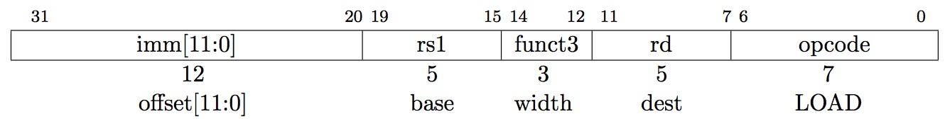
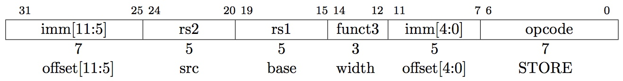
The RISC-V Lite Subset
ADD and SUB
  add rd,rs1,rs2
  sub rd,rs1,rs2
OR Immediate:
  ori rd,rs1,imm12
LOAD and
STORE Word
  lw rd,rs1,imm12
  sw rs2,rs1,imm12
BRANCH:
  beq rs1,rs2,imm12
Notes:
In today’s lecture, I will show you how to implement the following subset of RISC-V instructions: add, subtract, or immediate, load, store, branch, and the jump instruction.
The Add and Subtract instructions use the R format. The Op together with the Func fields together specified all the different kinds of add and subtract instructions.
Rs and Rt specifies the source registers. And the Rd field specifies the destination register.
The Or immediate instruction uses the I format. It only uses one source register, Rs. The other operand comes from the immediate field. The Rt field is used to specified the destination register. (Note that dest is the Rt field!)
Both the load and store instructions use the I format and both add the Rs and the immediate filed together to from the memory address.
The difference is that the load instruction will load the data from memory into Rt while the store instruction will store the data in Rt into the memory.
The branch on equal instruction also uses the I format. Here Rs and Rt are used to specified the registers we need to compare.
If these two registers are equal, we will branch to a location offset by the immediate field.
Finally, the jump instruction uses the J format and always causes the program to jump to a memory location specified in the address field.
I know I went over this rather quickly and you may have missed something. But don’t worry, this is just an overview. You will keep seeing these (point to the format) all day today.
+3 = 13 min. (X:53)

Slide 58
Register Transfer Language (RTL)
RTL gives the meaning of the instructions
All start by fetching the instruction
{op , rs1 , rs2 , rd , funct3} ← MEM[ PC ]
{op , rs1 , rs2 , Imm12} ← MEM[ PC ]
Inst Register Transfers
ADD R[rd] ← R[rs1] + R[rs2]; PC ← PC + 4
SUB R[rd] ← R[rs1] – R[rs2]; PC ← PC + 4
ORI R[rd] ← R[rs1] | sign_ext(Imm12); PC ← PC + 4
LW R[rd] ← MEM[ R[rs1] + sign_ext(Imm12)]; PC ← PC + 4
SW MEM[ R[rs1] + sign_ext(Imm12) ] ← R[rs2]; PC ← PC + 4
BEQ if ( R[rs] == R[rt] )
then PC ← PC + (sign_ext(Imm12) || 0)
else PC ← PC + 4

Slide 59
Step 1: Requirements of the Instruction Set
Memory (MEM)
  Instructions & data (will use one for each: really caches)
Registers (R: 32 x 32)
  Read rs1
  Read rs2
  Write rd
PC
Sign Extender
Add/Sub/OR unit for operation on register(s) or sign extended immediate
Add 4 (or maybe sign extended immediate) to PC
Compare if registers equal?

Slide 60
Generic Steps of Datapath
rd
PC
instruction
memory
registers
rs1
Data
memory
ALU
rs2
+4
imm
mux
2. Decode/
Register
Read
1. Instruction
Fetch
5. Register
Write
3. Execute
4. Memory

Slide 61
Step 2: Components of the Datapath
Combinational Elements
State Elements + Clocking Methodology
Building Blocks
OP
CarryIn
Select
A
A
32
A
32
32
Zero
Adder
Sum
MUX
ALU
Result
32
Y
32
32
B
CarryOut
B
B
32
32
32
Adder
Multiplexer
ALU

Slide 62
ALU Needs for RISC-V Lite + Rest of RISC-V
Addition, subtraction, logical OR, ==:
  ADD R[rd] = R[rs1] + R[rs2]; ...
  SUB R[rd] = R[rs1] – R[rs2]; ...
  ORI R[rt] = R[rs1] | sign_ext(Imm12)...
  BEQ if ( R[rs] == R[rt] )...
Test to see if output == 0 for any ALU operation gives == test. How?
P&H Ch. 4 also adds AND, 64 bit LD/SD instructions
ALU from Appendix A, Section A.5

Slide 63
Storage Element: Idealized Memory
Write Enable
Address
Memory (idealized)
  One input bus: Data In
  One output bus: Data Out
Memory word is found by:
  Address selects the word to put on Data Out
  Write Enable = 1: address selects the memory
  word to be written via the Data In bus
Clock input (CLK)
  CLK input is a factor ONLY during write operation
  During read operation, behaves as a combinational logic block: Address valid ⇒ Data Out valid after “access time”
Data In
DataOut
32
32
Clk
Notes:
The last storage element you will need for the datapath is the idealized memory to store your data and instructions.
This idealized memory block has just one input bus (DataIn) and one output bus (DataOut).
When Write Enable is 0, the address selects the memory word to put on the Data Out bus.
When Write Enable is 1, the address selects the memory word to be written via the DataIn bus at the next clock tick.
Once again, the clock input is a factor ONLY during the write operation.
During read operation, it behaves as a combinational logic block.
That is if you put a valid value on the address lines, the output bus DataOut will become valid after the access time of the memory.
+2 = 35 min. (Y:15)

Slide 64
Storage Element: Register (Building Block)
Write Enable
Similar to D Flip Flop except
  N-bit input and output
  Write Enable input
Write Enable:
  Negated (or deasserted) (0): Data Out will not change
  Asserted (1): Data Out will become Data In on rising edge of clock
Data In
Data Out
N
N
clk
Notes:
As far as storage elements are concerned, we will need a N-bit register that is similar to the D flip-flop I showed you in class.
The significant difference here is that the register will have a Write Enable input.
That is the content of the register will NOT be updated if Write Enable is not asserted (0).
The content is updated at the clock tick ONLY if the Write Enable signal is asserted (1).
+1 = 31 min. (Y:11)

Slide 65
Storage Element: Register File
RW
RA
RB
Write Enable
5
5
5
Register File consists of 32 registers:
  Two 32-bit output busses:
  busA and busB
  One 32-bit input bus: busW
Register is selected by:
  RA (number) selects the register to put on busA (data)
  RB (number) selects the register to put on busB (data)
  RW (number) selects the register to be written
  via busW (data) when Write Enable is 1
Clock input (clk)
  Clk input is a factor ONLY during write operation
  During read operation, behaves as a combinational logic block:
    RA or RB valid ⇒ busA or busB valid after “access time.”
busA
busW
32 x 32-bit
Registers
32
32
busB
Clk
32
Notes:
We will also need a register file that consists of 32 32-bit registers with two output busses (busA and busB) and one input bus.
The register specifiers Ra and Rb select the registers to put on busA and busB respectively.
When Write Enable is 1, the register specifier Rw selects the register to be written via busW.
In our simplified version of the register file, the write operation will occurs at the clock tick.
Keep in mind that the clock input is a factor ONLY during the write operation.
During read operation, the register file behaves as a combinational logic block.
That is if you put a valid value on Ra, then bus A will become valid after the register file’s access time.
Similarly if you put a valid value on Rb, bus B will become valid after the register file’s access time. In both cases (Ra and Rb), the clock input is not a factor.
+2 = 33 min. (Y:13)

Slide 66
Step 3: Assemble DataPath Meeting Requirements
Register Transfer Requirements ⇒ Datapath Assembly
Instruction Fetch
Read Operands and Execute Operation
Common RTL operations
  Fetch the Instruction:
  mem[PC]
  Update the program counter:
    Sequential Code:
    PC ← PC + 4
    Branch and Jump:
    PC ← “something else”
clk
PC
Next Address
Logic
Address
Instruction Word
Instruction
Memory
32

Slide 67
Step 3: Add & Subtract
R[rd] = R[rs] op R[rt] (addu rd,rs,rt)
  Ra, Rb, and Rw come from instruction’s Rs1, Rs2, and Rd fields
  ALUctr and RegWr: control logic after decoding the instruction
… Already defined the register file & ALU
rd
rs1
rs2
RegWr
ALUctr
5
5
5
busA
Rw
Ra
Rb
Zero
busW
32
32
32 x 32-bit
Registers
ALU
busB
32
clk
Result
32
Notes:
And here is the datapath that can do the trick.
First of all, we connect the register file’s Rw, Ra, and Rb input to the Rd, Rs, and Rt fields of the instruction bus (points to the format diagram).
Then we need to connect busA and busB of the register file to the ALU.
Finally, we need to connect the output of the ALU to the input bus of the register file.
Conceptually, this is how it works.
The instruction bus coming out of the Instruction memory will set the Ra and Rb to the register specifiers Rs and Rt.
This causes the register file to put the value of register Rs onto busA and the value of register Rt onto busB, respectively.
By setting the ALUctr appropriately, the ALU will perform either the Add and Subtract for us.
The result is then fed back to the register file where the register specifier Rw should already be set to the instruction bus’s Rd field.
Since the control, which we will design in our next lecture, should have already set the RegWr signal to 1, the result will be written back to the register file at the next clock tick (points to the Clk input).
+3 = 42 min. (Y:22)

Slide 68
Agenda
Boolean Algebra
Timing and State Machines
Datapath Elements: Mux + ALU
RISC-V Lite Datapath
And, in Conclusion, …

Slide 69
And in Conclusion, …
State Machines
  Finite State Machines: made from Stateless combinational logic and Stateful “Memory” Logic (aka Registers)
  Clocks synchronize D-FF change (Setup and Hold times important!)
  Pipeline long-delay CL for faster clock cycle—
  Split the critical path
Use muxes to select among inputs
  S input bits selects 2^{S} inputs
  Each input can be n-bits wide,
  independent of S
Can implement muxes hierarchically
Arithmetic circuits are a kind of combinational logic
Processor
Input
Control
Memory
Datapath
Output
Five steps to processor design:
  1. Analyze instruction set → datapath requirements
  2. Select set of datapath
  components & establish clock methodology
  3. Assemble datapath meeting the requirements
  4. Analyze implementation of each instruction to determine setting of control points that effects the register transfer.
  5. Assemble the control logic
    Formulate Logic Equations
    Design Circuits

